Slide 1
HomeTrak Online
For Caregivers

Slide 2
HTOnline for Caregivers
HomeTrak Online is a web portal that can be accessed from your phone, tablet or computer.
You can see your Calendar of schedules in an Agenda, Weekly or Monthly view.
You can see your schedule details, start/end times, length of schedule, client’s name and address.
You can see the Duties to Perform you need to complete during your schedule.
You can write a Care Note to communicate information back to the office.
You can capture the Client’s Signature and your signature for each schedule worked.
You have access to Saved Reports, like the client’s care plan.
If you’ve been given access, you can add your Availability.
01

Slide 3
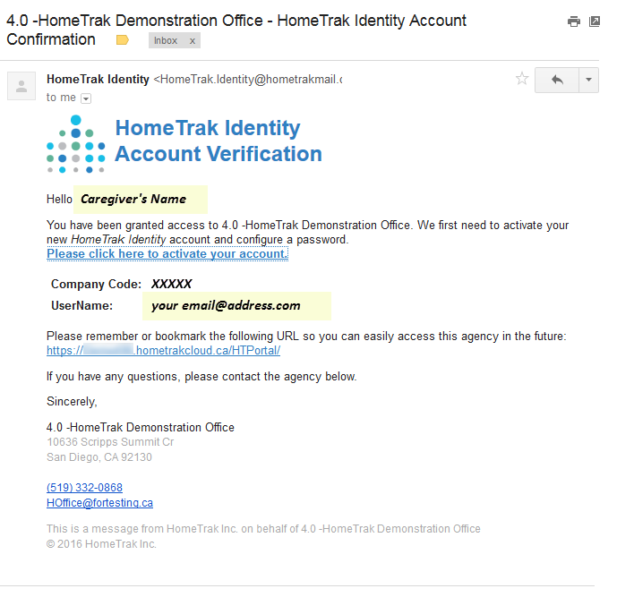
Getting Started
Account Activation
You will receive an email from HomeTrak Identity which asks you to click on the link to activate your account.
The Create Password screen will appear. Your Username is your email address and will already be populated for you. Enter your Password in the password and confirm password fields, then click Change Password to save.
The Log In screen will appear.
02

Slide 4
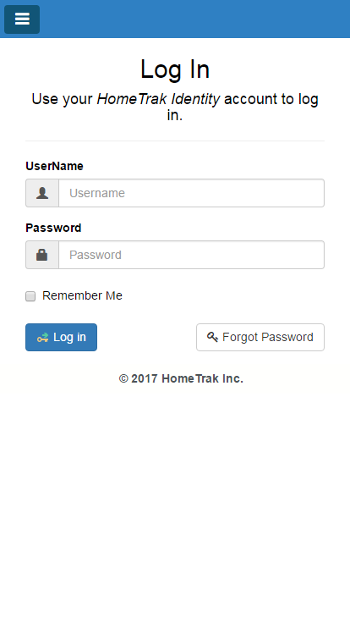
Log in
Log In Screen
The Log In screen can be accessed from your phone, tablet or computer using a web browser such as Chrome, Firefox or Safari if using an iOS (Apple) device.
Type in your Username and Password then click Log In button.
If located in the USA use the website https://www.hometrakcloud.com/.
if located in Canada use the website https://www.hometrakonline.ca/.
Add the website to the home page of your phone or tablet: click here for instructions. Or add to your Favorites if working on a computer.
03

Slide 5
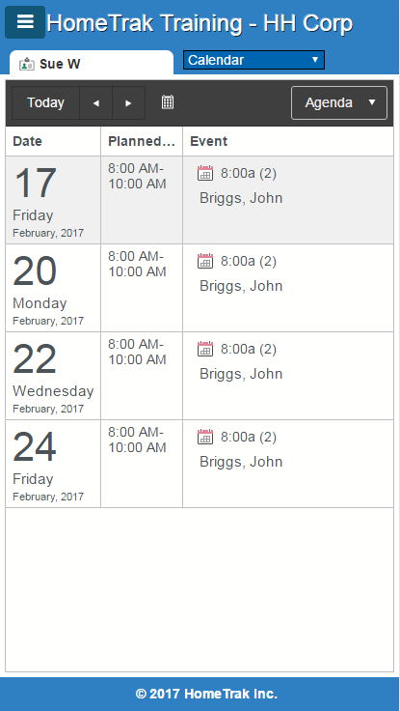
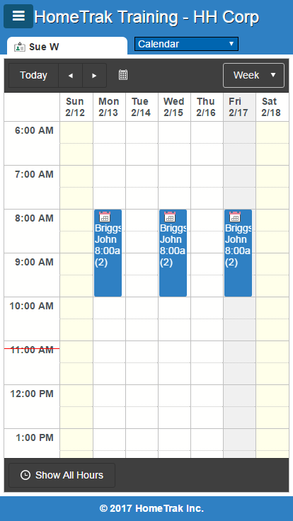
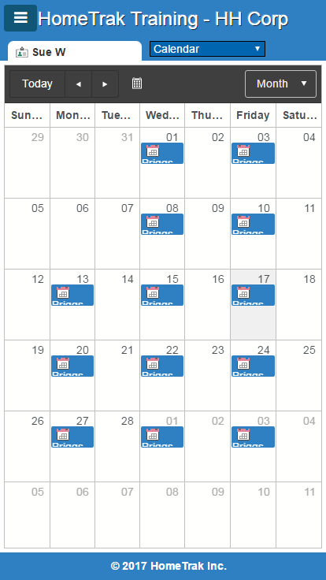
Calendar Views
Once logged in, you will see an Agenda view of schedules on your calendar.
Change the view to Week or Month by clicking on the Agenda drop-down menu. Click here for instructions on using the Calendars.
04

Slide 6
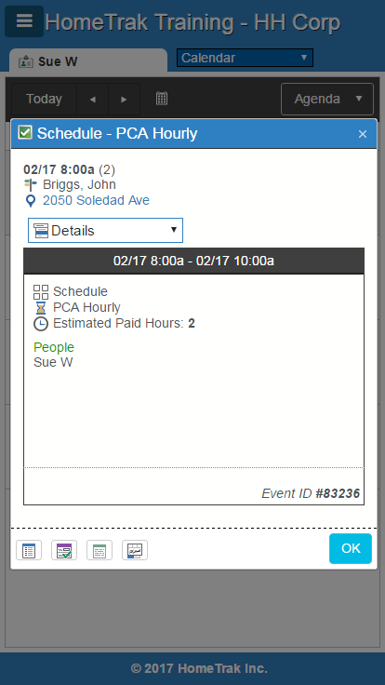
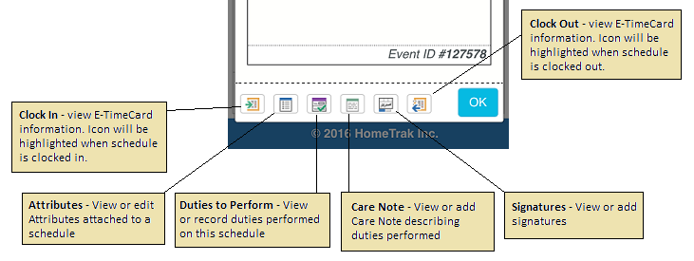
Schedules
From any of the Calendar views you can tap a schedule to see the details.
Schedules Details:
Date, Start/End Time and Hours (length of schedule)
Client’s Name and Address (tap the address to get mapping details)
Type of work you are performing. This example shows PCA Hourly.
Estimated Paid Hours
Below is a close up view of the bottom of the schedule with explanation of the buttons:
05

Slide 7
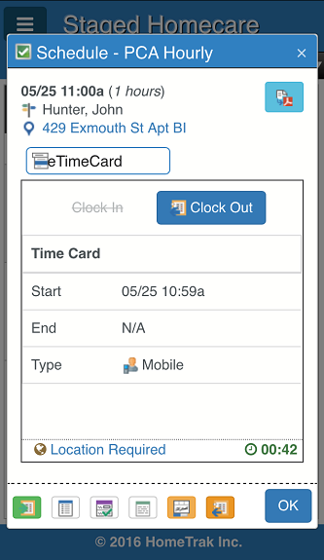
Clock In & Out for Schedules
From any of the Calendar views, you can tap a schedule to clock in or out.
Your GPS or Location Services needs to be enabled on your device. To verify this is working, open your maps app and make sure that it shows a pin at your current location.
Troubleshooting:
When starting or ending a visit, if you receive an indication that you are not close enough to the location ("xx meters/yards out of range"), try moving to the front door, or stepping outside of the building to get a clear signal and refresh your location.
If one or both of the Clock In or Clock Out options is not visible, you may be too far from the original scheduled time of the schedule. You may need to contact your office to adjust the schedule time in this case.
06

Slide 8
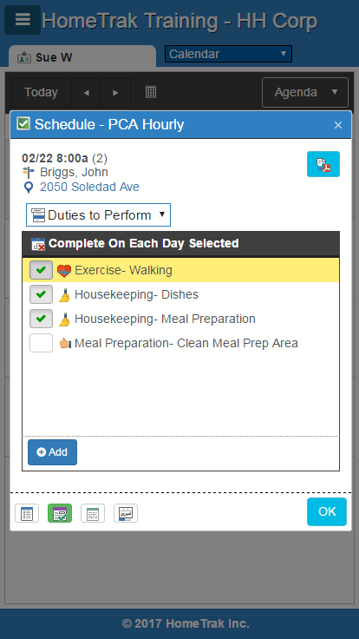
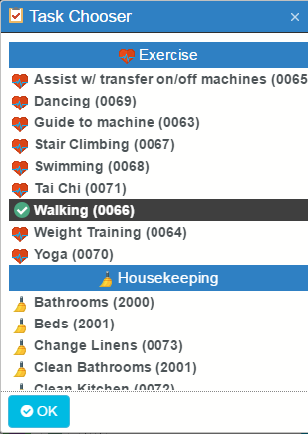
Check off Duties to Perform
From any of the Calendar views you can tap a schedule then tap the Details drop-down menu and tap Duties to Perform.
Tap the box beside each task to show you’ve completed the task.
Click the Add button to open the Task Chooser screen.
Scroll through the list and tap each task you have completed to add to the current list.
The list will be attached to the schedule and visible to the Office Staff
07

Slide 9
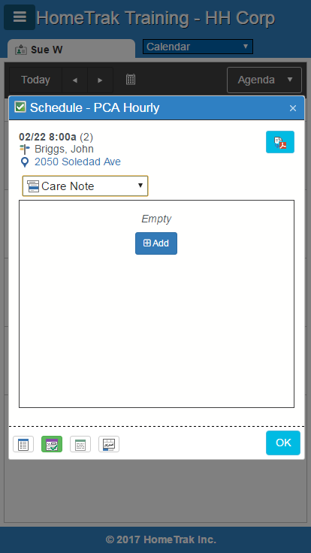
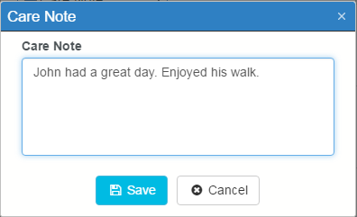
Add Care Note
From any of the Calendar views you can tap a schedule then tap the Details drop-down menu and tap Care Note.
Click the Add button to open the Care Note screen.
Type in a brief note, then click Save.
The note will be attached to the schedule and visible to the Office Staff.
08

Slide 10
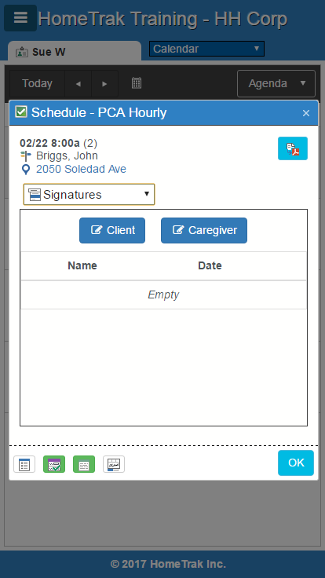
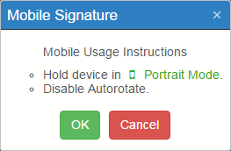
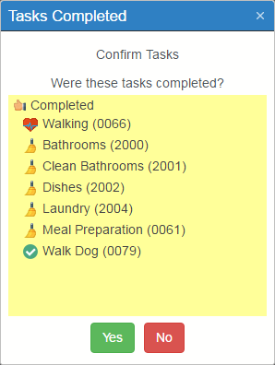
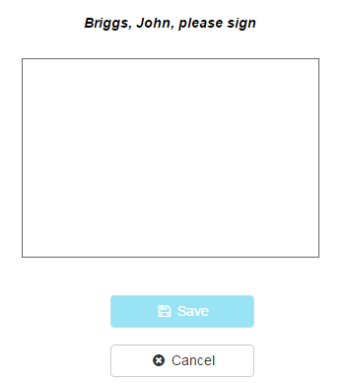
Capturing Signatures
From any of the Calendar views you can tap a schedule then tap the Details drop-down menu and tap Signatures.
Click the Client button to open the Mobile Signature screen.
Click OK, the Tasks Completed screen appears. Client will click Yes or No.
If they click Yes, the signature screen opens for them to sign. Click Save. Repeat steps for Caregiver’s signature if required. If not, click OK.
The signatures will be attached to the schedule and visible to the Office Staff.
09

Slide 11
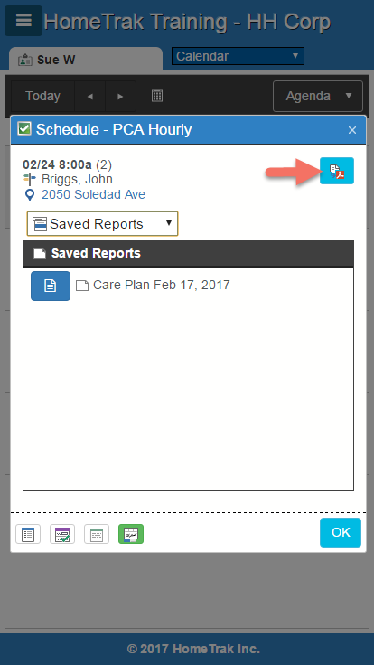
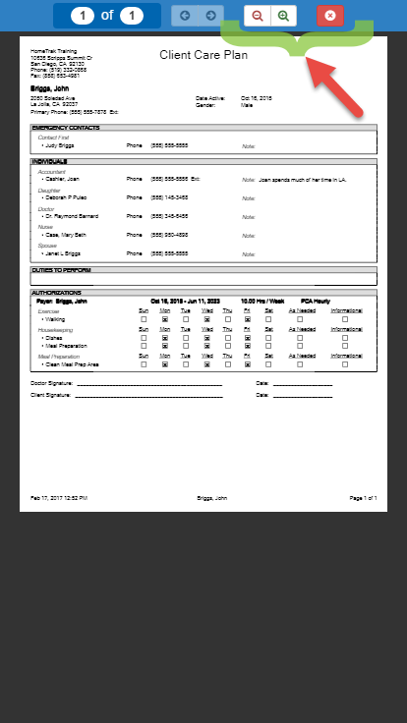
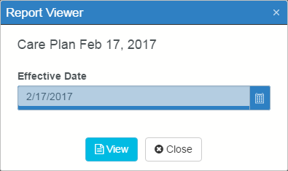
Saved Reports
From any of the Calendar views you can tap a schedule then tap the Details drop-down menu and tap Saved Reports.
Click the Report icon to open the Report Viewer screen.
You then can use the icons on the report toolbar to zoom in or out and close the report.
10

Slide 12
www.hometrak.com/support
Facebook.com/hometrak/
HomeTrak Support
assistance@hometraksupport.com
HOME

